Slide 1

Software requirements (swr302)
Risk reduction through prototyping (chapter 15)

Slide 2
Prototyping: What and why
Purpose:
Clarify, complete, and validate requirements
Explore design alternatives
Create a subset that will grow into the ultimate product
Three classes of prototype attributes
Scope:
mock-up prototype => UX
proof-of-concept prototype => Technical Approach
Future use: throwaway vs. evolutionary prototype
Form: paper vs. electronic prototype

Slide 3
Mock-ups and proofs of concept
Definition: people say “software prototype,” they are usually thinking about a mock-up of a possible user interface. A mock-up is also called a horizontal prototype.
A proof of concept, also known as a vertical prototype, implements a slice of application functionality from the user interface through all the technical services layers
Purpose:
demonstrate the functional options the user will have available, the look and feel of the user interface (layout, colors, graphics, controls), and the navigation structure
explore some specific behaviors of the intended system, with the goal of refining the requirements
represent the developer’s concept of how a specific use case might be implemented
…

Slide 4
Throwaway prototypes
Purpose: build a throwaway prototype to answer questions, resolve uncertainties, and improve requirements quality
A wireframe is a particular approach to throwaway prototyping commonly used for custom user interface design and website design.
You can use wireframes to reach a better understanding of three aspects of a website:
The conceptual requirements
The information architecture or navigation design
The high-resolution, detailed design of the pages

Slide 5
Evolutionary prototypes
Purpose: provides a solid architectural foundation for building the product incrementally as the requirements become clear over time.
Agile development provides an example of evolutionary prototyping. Agile teams construct the product through a series of iterations, using feedback on the early iterations to adjust the direction of future development cycles.
Evolutionary prototyping is well suited for web development projects

Slide 6
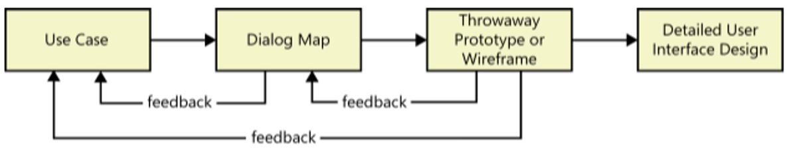
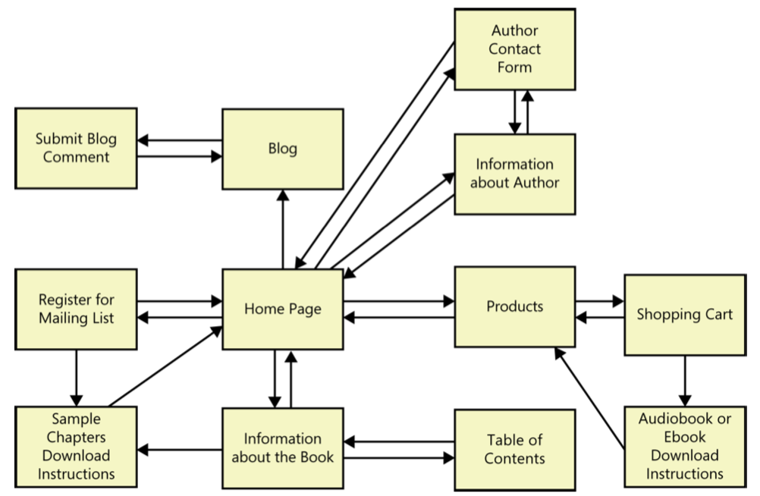
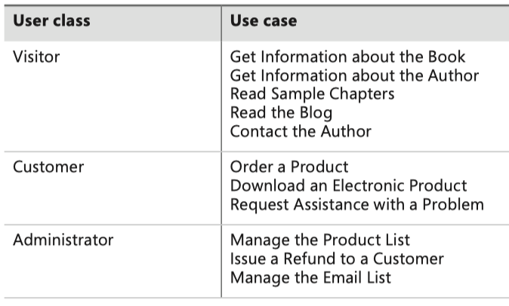

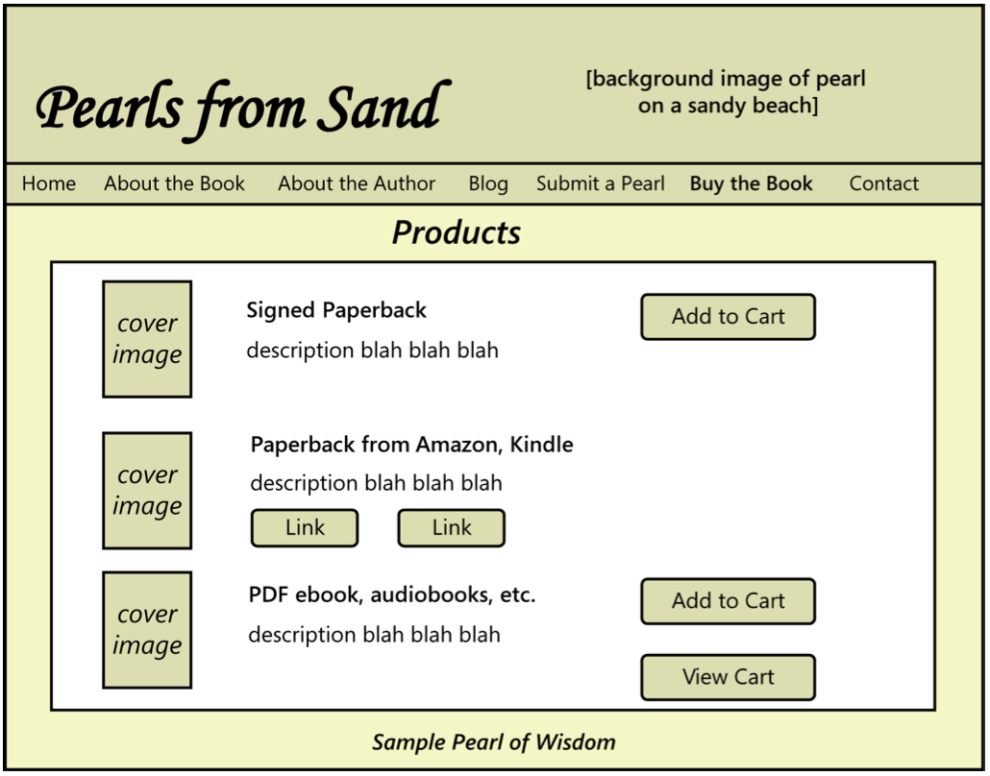
Working with prototypes

Slide 7
Working with prototypes
Prototype evaluation - You might ask the following questions:
Does the prototype implement the functionality in the way you expected?
What functionality is missing from the prototype?
Can you think of any possible error conditions that the prototype doesn’t address?
Are any unnecessary functions present?
How logical and complete does the navigation seem to you?
Are there ways to simplify any of the tasks that require too many interaction steps?
Were you ever unsure of what to do next?
Risks of prototyping
Pressure to release the prototype
Distraction by details
Unrealistic performance expectations
Investing excessive effort in prototypes

Slide 8


